Slide 1
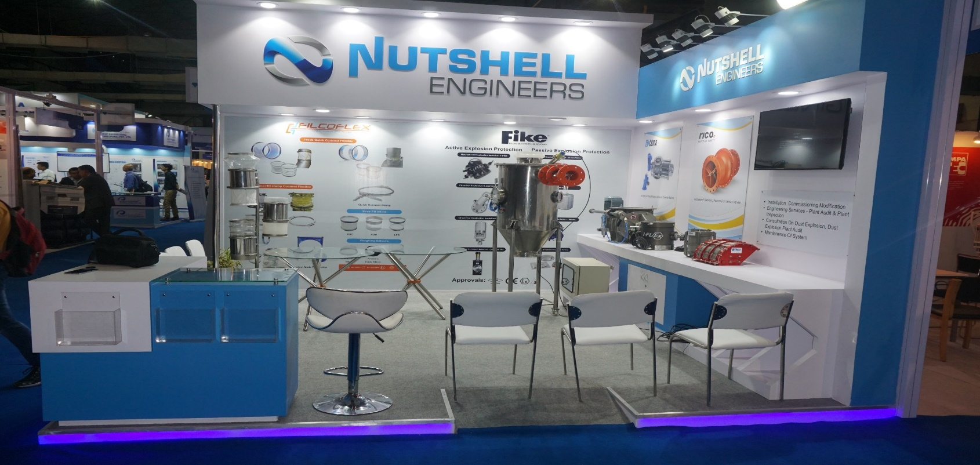
Nutshell Engineers

Slide 2
Products:
Safety Relief Valves
Flame Arrestors
Breather Valves
Explosion Protection Systems
Rupture Discs
Explosion Vents
Food Grade Flexible Connection
Rotary Valves and Diverters

Slide 3
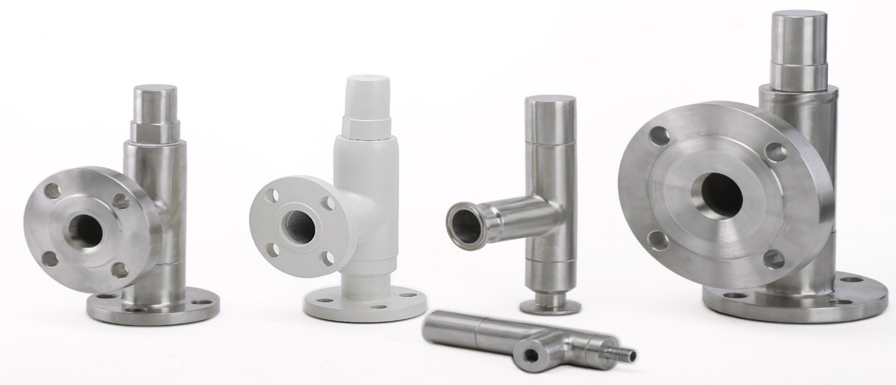
Safety Relief Valves
Designed as per ASME and API Standards.
Manufactured from Solid Bar-Stock.
Size: From ½” to 4”.
Material: SS 304/316, CS.
Special materials available on requests.
Set Pressure: 0.5 kg/cm2g to 40 kg/cm2g.
End Connection: Flanged/Threaded/TriClover.
We just don’t sell products, we deliver solutions…!

Slide 4
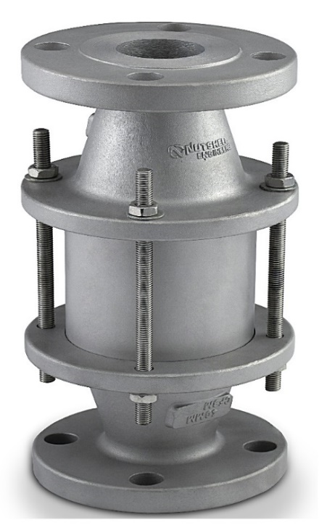
Flame Arrestors
Types: Inline and End of Line Flame Arrestor.
CMRI Certified IS:16484 2016.
Gas Group: IIA, IIB1, IIB2, IIB3.
Sizes: 1’’,1.5’’,2’’,3’’,4’’,6’’,8’’.
End Connection: Flanged to ANSI B16.5 #150 RF.
Body Material: CS, Stainless CF8, CF8M.
Corrugated Matrix in SS316, Hastelloy C276.
Provide ATEX Certification on request.
We just don’t sell products, we deliver solutions…!

Slide 5
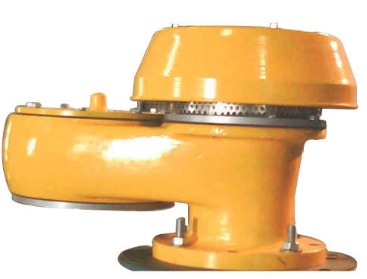
Breather Valve
Manufacturer: Pre’con has over 30 years of manufacturing experience.
Type: Weight Loaded/Spring Loaded.
Protect the tank against over Pressure/over Vacuum.
Vent Capacity as per API 2000.
Sizes: 1’’,1.5’’,2’’,3’’,4’’,6’’,8’’.
Body Material: CS, Stainless CF8, CF8M.
End Connection: Flanged to ANSI B16.5 #150 RF.

Slide 6
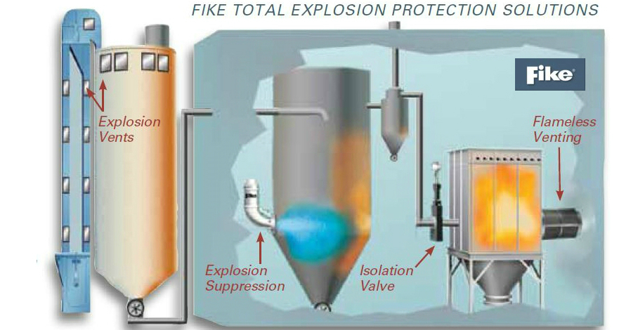
Explosion Protection
Active and Passive Explosion Protection systems.
Designed as per ATEX or NFPA standards.
Complete end to end solution including site survey, design, supply and commissioning.

Slide 7
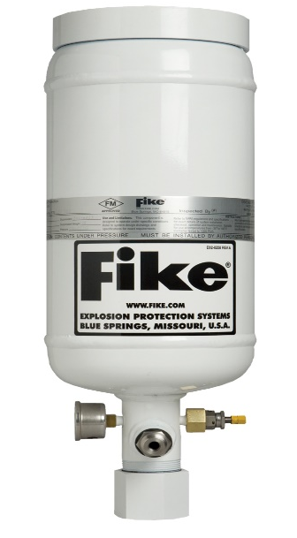
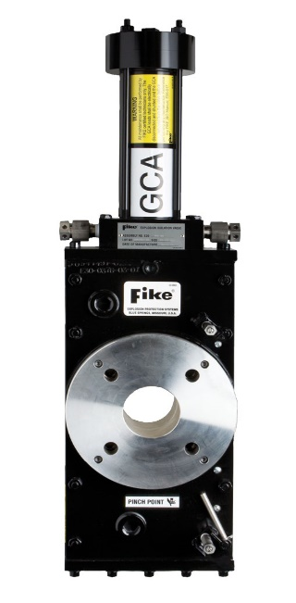
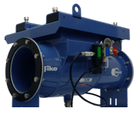
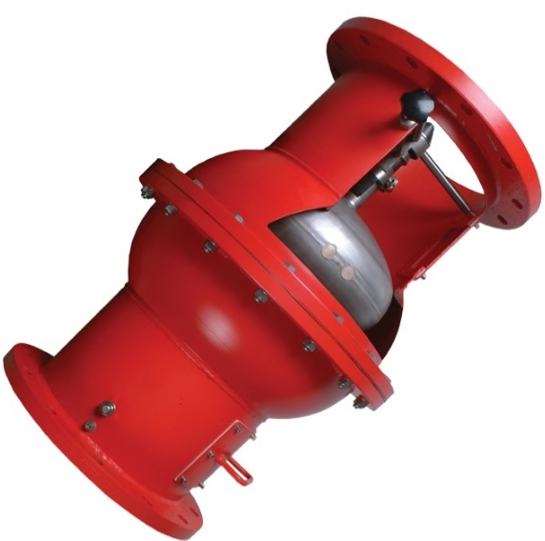
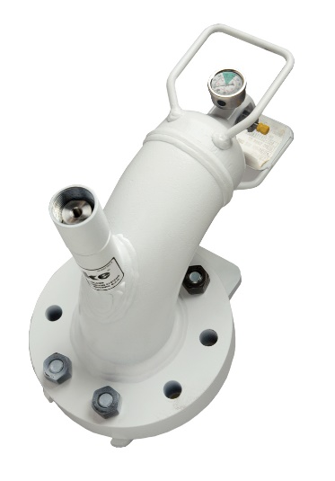
Explosion Protection component
Passive
Active

Slide 8
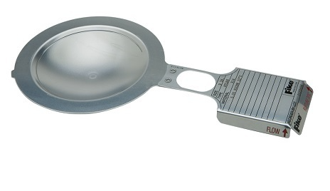
Rupture discs
Manufacturer: Fike has over 60 years of manufacturing experience.
Different sizes and material available on request.
Non Fragmenting design.
Application specific design for SIP / CIP.
Suitable for Liquid, Vapour and Gas Applications.
Application specific designs available on request.

Slide 9
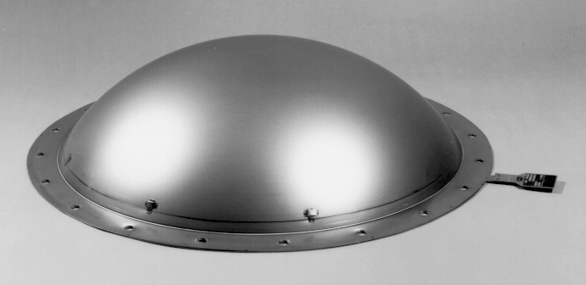
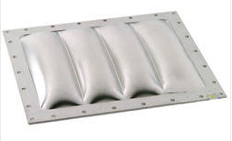
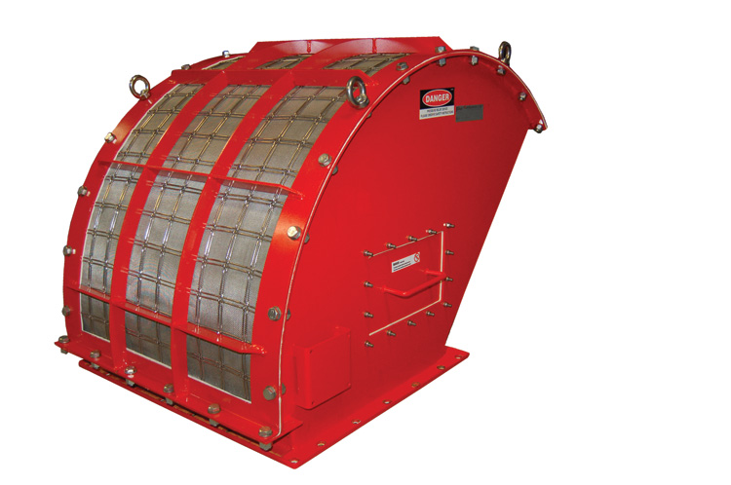
Explosion Vents
Manufacturer: Fike
Different sizes and material available on request.
Non Fragmenting design.
ATEX certified
Application specific designs available on request.

Slide 10
Flexible connections
Manufacturer: Filcoflex has over 30 years of experience.
Clean, Safe and Efficient flexible connections for Food, Pharmaceutical, Chemical and Mineral industries.
Major player in the dry substances sector, with products for bulk and powder transport systems.
FDA and ATEX certified.
Specializes in Custom made production.
Anti-static flexible connections.
Jacob Flexible Connection
Can be welded directly to the pipework with the help of Jacob accessories.
Available in different material as per application.

Slide 11
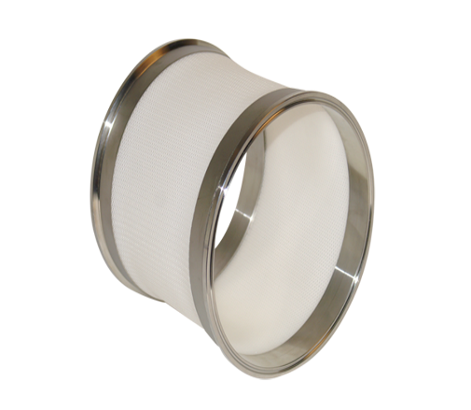
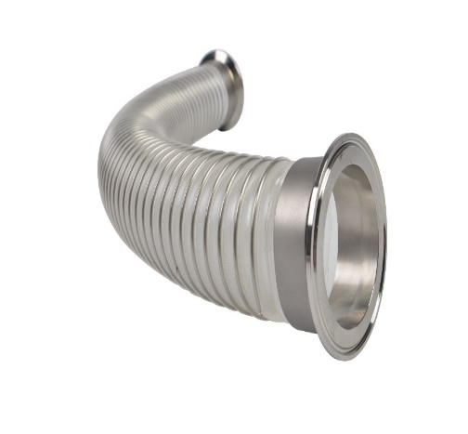
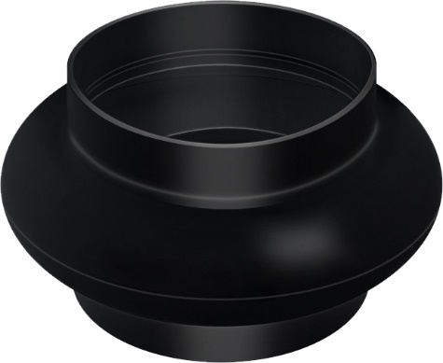
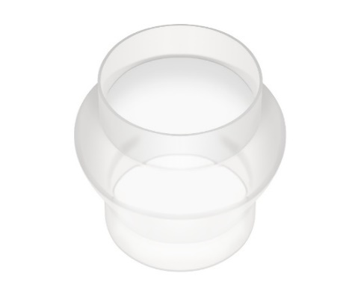
Tri-Clamp Flexible Connection
Ideal for short term process lines and equipment.
Often used in Pharmaceutical and Chemical Plants.
Weighing Flexible Connection
Special design and high quality flexible material
Applications: as a connection for weighing and dosing equipment
Little or no effect on weighing and or dosing processes.

Slide 12
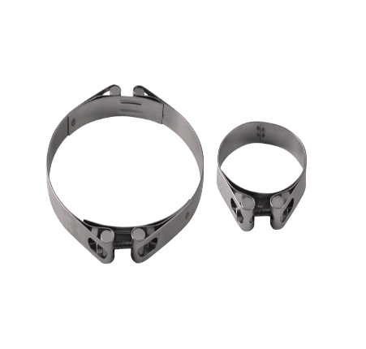
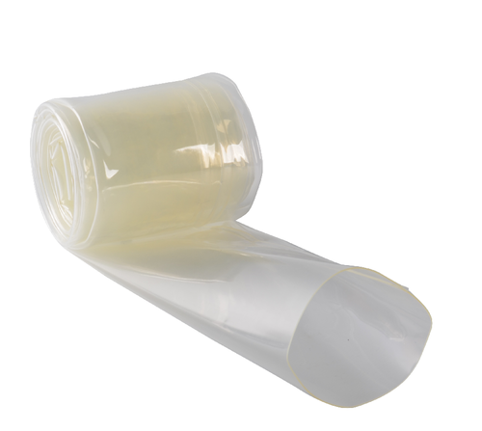
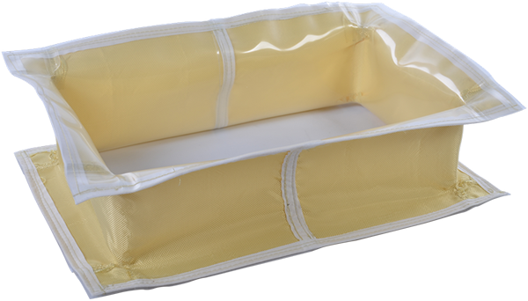
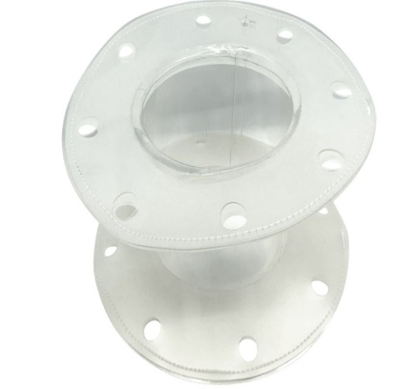
Hose on Roll and Hose clamps
Specialise in rubber hoses which can be stored and cut as per required length.
Available up to 3meter continuous length.
Hose clamps available in SS 304 material.
Custom made Flexible connection
Specialise for Flange fitted connections, conical bellows.
As per required designs.

Slide 13
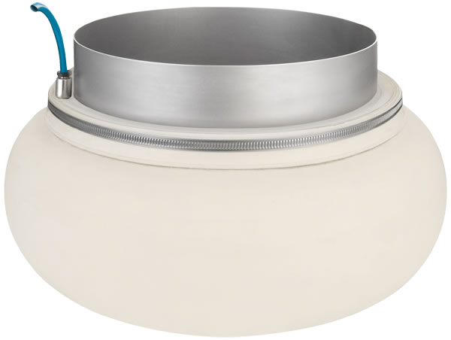
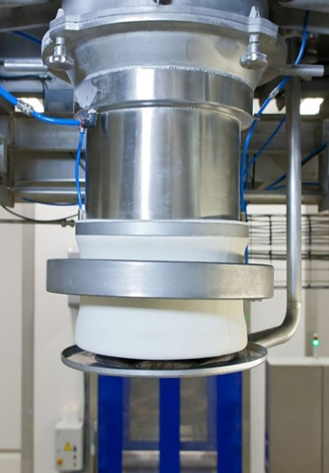
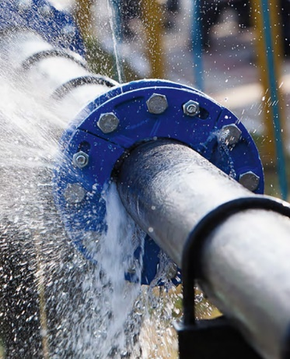
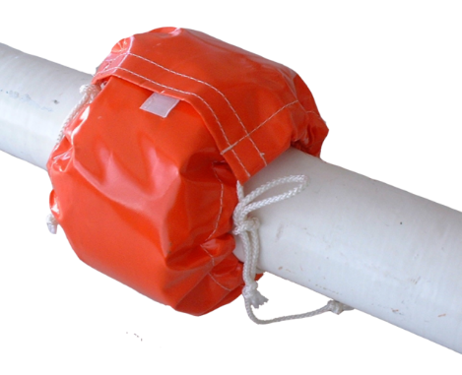
Innovative Seals
*Inflatable Bag Clamp
Used for Big Bag/Bag filling and keeps work environment dust free.
Custom made in all pipe diameters, bag diameters and different lengths.
Bag clamps can be filled with 1 or more pneumatic fittings with 2 choice of fittings.
*Spray Shield
Used to detect leakages in pipeline of liquids, gases by change in colour.
Chemically Resistant and Indicative material.
High and low Temperature Resistant.

Slide 14
Rotary Valves
Manufacturer: TBMA has over 50 years of experience
Types: Rotary drop-through and blow-through valves for the Process industry.
Suitable for conveying of powders and granules in the food, dairy, animal feed, chemical and mineral industries as well as for value-added logistics.
ATEX 95 Certified.
High Duty Rotary Valves
H-AR
H-GR
H-AX
ATEX 2014/34/EU certiﬁed.
Explosion resistant (Autonomous Protective System up to 10 Barg for products in dust class St1 and St2).
Handling “difficult” products (sticky, glazing etc).
High Temperature Applications (up to 600°C).
Applications where Stainless Steel is mandatory.

Slide 15
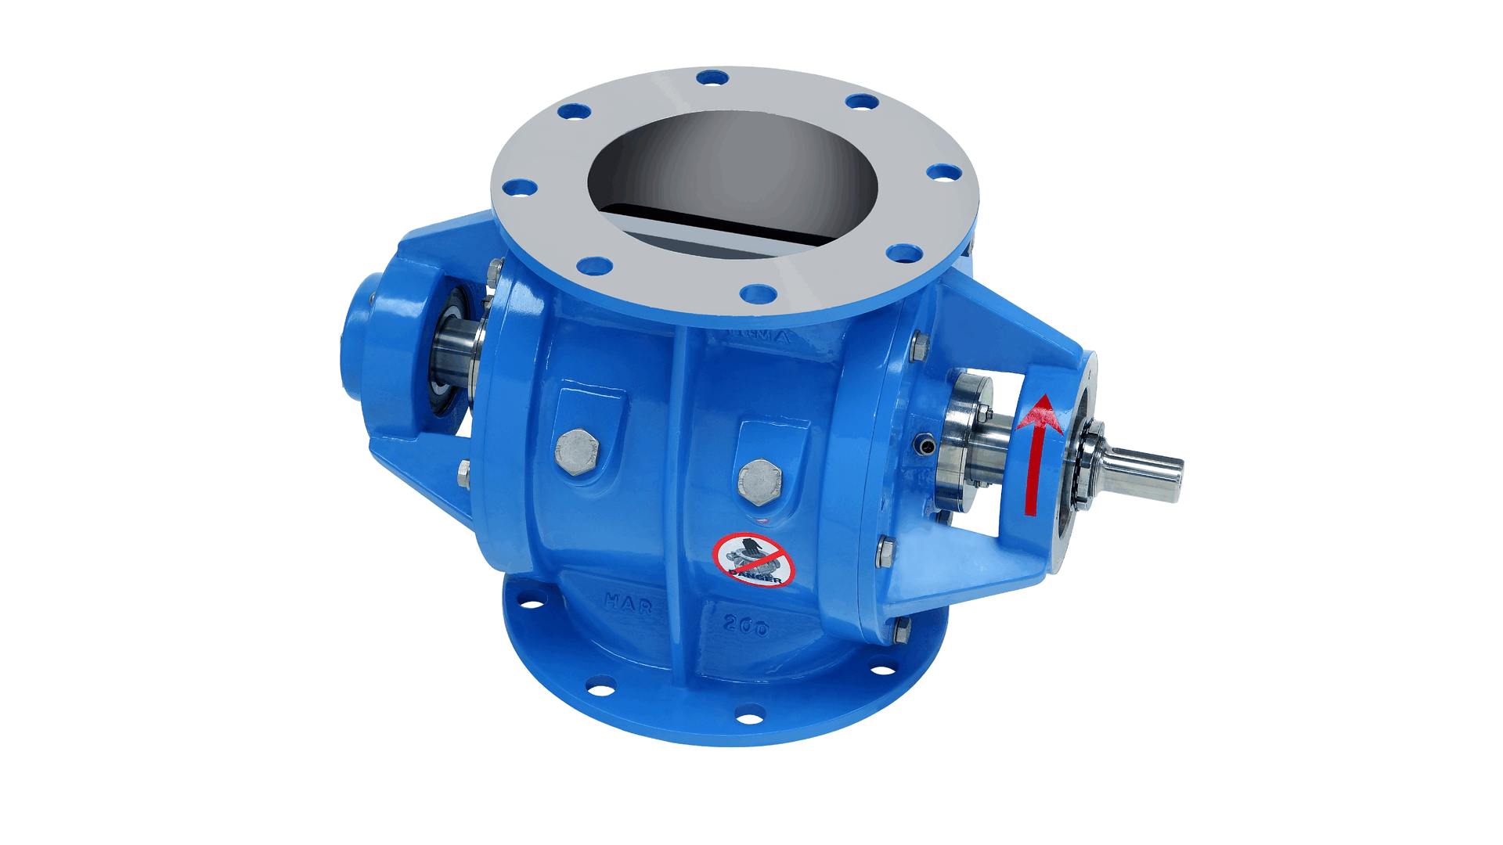
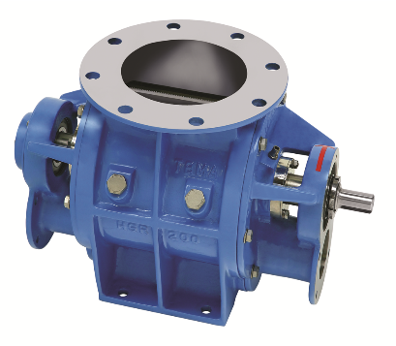
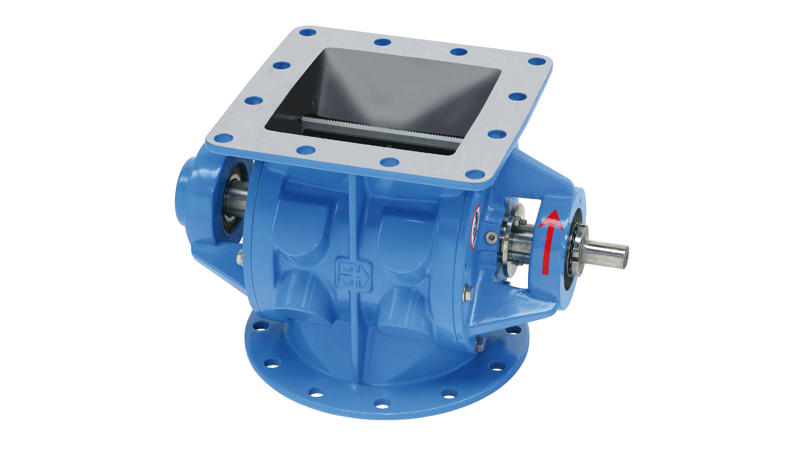
Rotary Valve H-AR
Rotary Valve H-GR
Rotary Valve H-AX
Drop-through Rotary Valve.
High ﬁlling degree and large capacity with minimal air leakage.
Flange sizes, DN150 to DN500.
Rotor Volume, 2.5 to 125 Ltr/revolution.
Available with Chain drive and Direct drive.
Blow-through Rotary Valve.
Used for direct dosing and equipped with connecting flanges for direct mounting into pneumatic conveying systems.
Flange sizes, DN150 to DN350.
Rotor Volume, 2.5 to 58 Ltr/revolution.
Available with Chain drive and Direct drive.
Drop-through Rotary Valve.
Used when the inlet size is more important than the rotor volume.
Equipped with a round and a square connecting ﬂange.
Used as a transition piece from round to square or vice versa.
Flange sizes, DN150 to DN350
Rotor Volume, 2.5 to 34 Ltr/revolution.
Available with Chain drive and Direct drive.

Slide 16
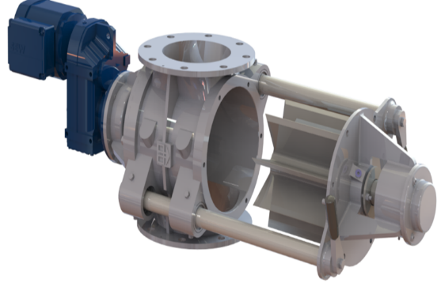
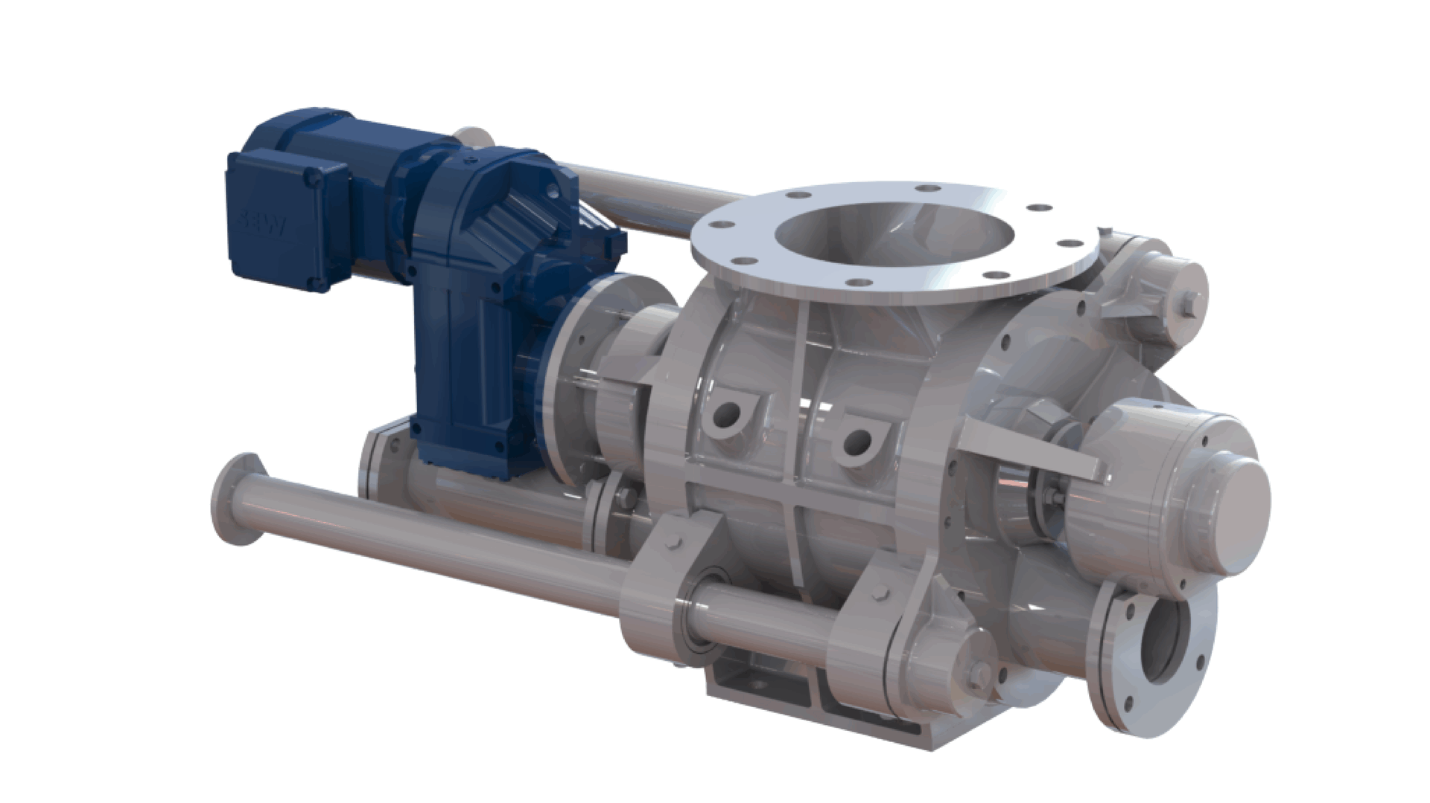
Quick Clean Rotary valves (DG)
Specially designed for processes where frequent cleaning and inspection are required.
Equipped with guiding bars and available in both drop-through (H-ARDG) as well as blow-through (H-GRDG) version.
Medium Duty Rotary Valves
M-AX
R-AX
Specially designed for standard applications with limited differential pressure.
Used for dosing of non-abrasive materials under cyclones or ﬁlters and in low-pressure pneumatic transport systems.
Available sizes: DN150 to DN350

Slide 17
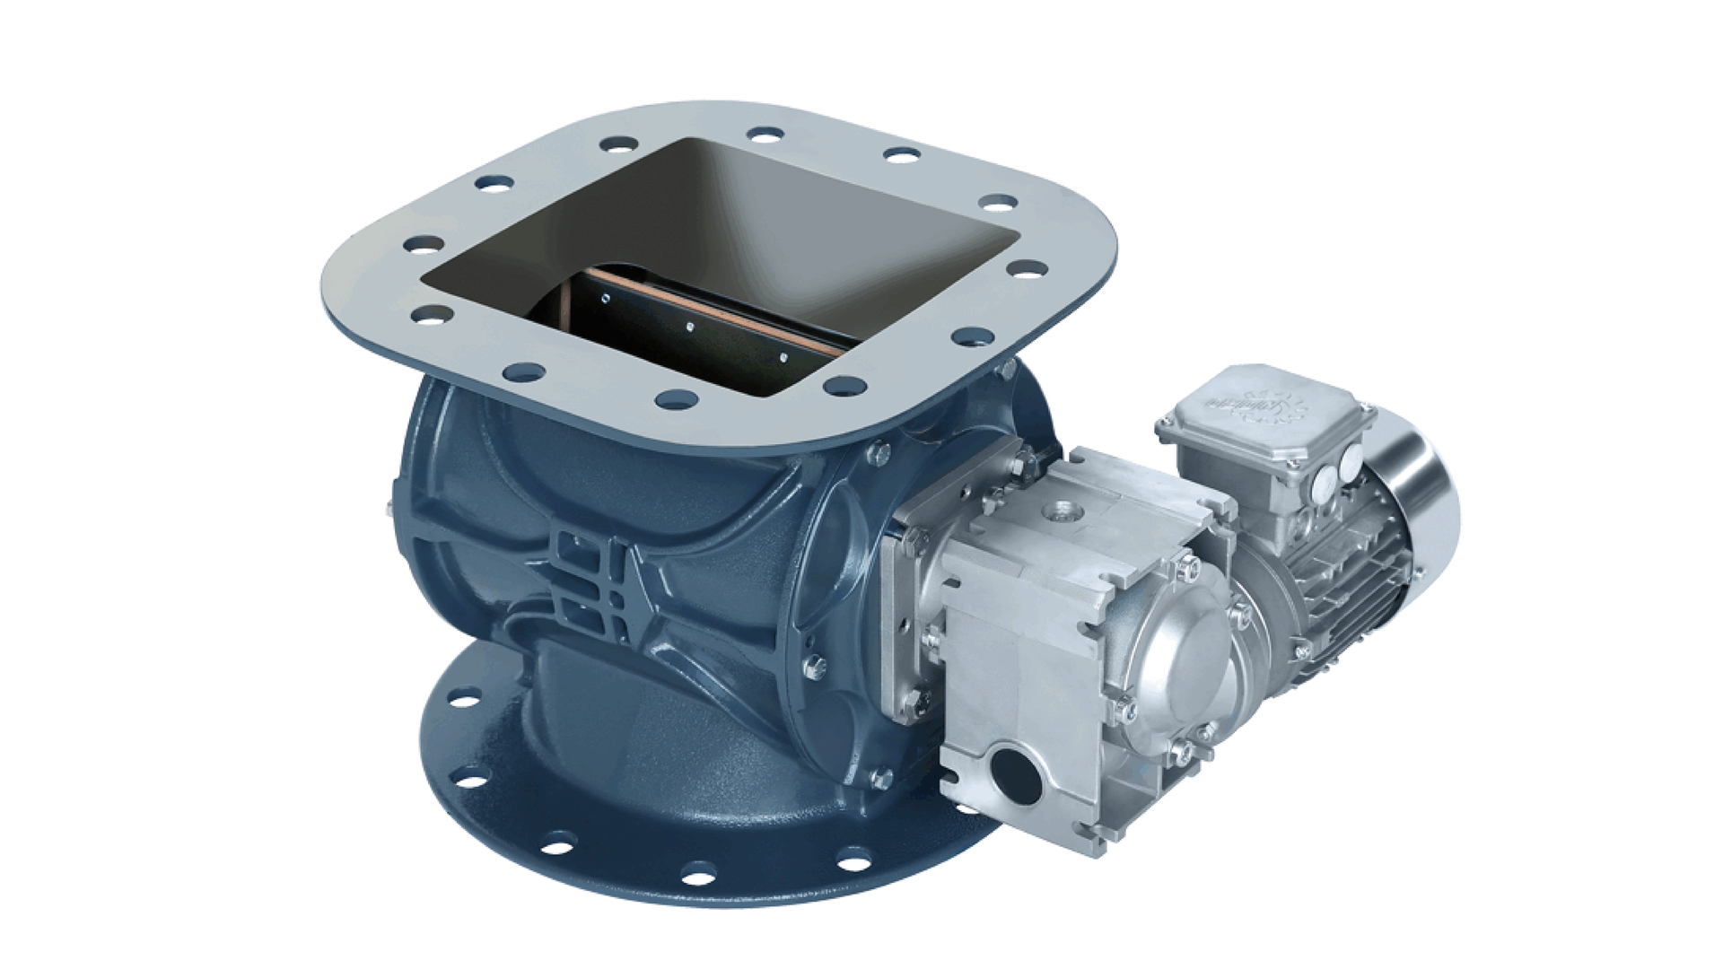
Dust and Cyclone Valves
Rotary Valve S-AX
Specially designed to be used under dust ﬁlters and cyclones.
Applications with a differential pressure up to 500 mbar where the valve primarily functions as an airlock or explosion barrier.
Available size DN250 (Round/Square flange)
Made from GGG50 Smart-Lite™ nodular cast iron.
Features of cast iron material: stronger than conventional cast iron, much less brittle making, more resistant to shock loads, and high corrosion resistance.
Installation weight: only 60.5 kg (standard version).
Equipped with a round and a square connecting ﬂange.
Used as a transition piece from round to square and vice versa.

Slide 18
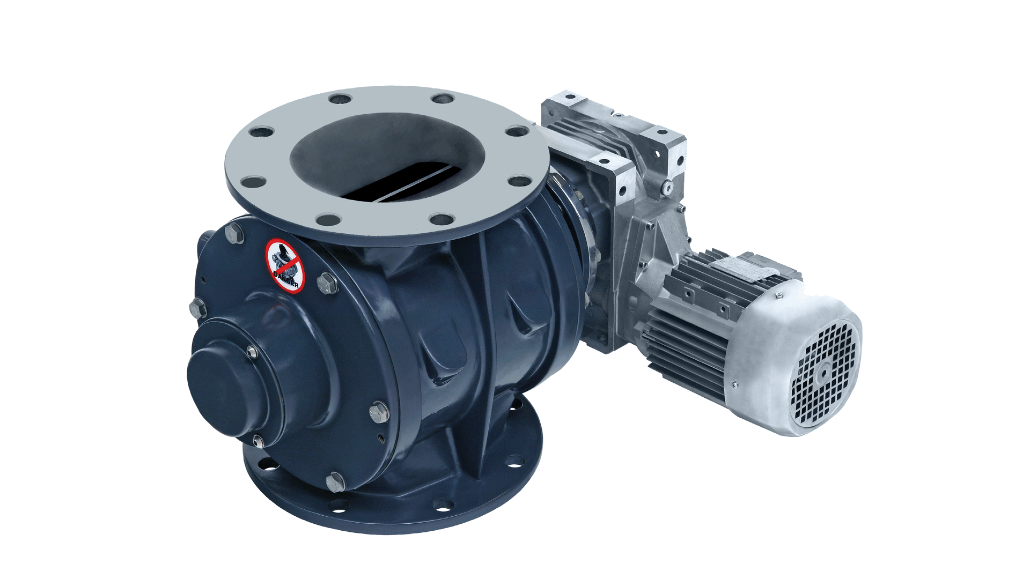
Rotary Valve M-AX
Rotary Valve R-AX
Equipped with a round and a square connecting ﬂange.
Used as a transition piece from round to square or vice versa.
Favorable for the installation height and saves any mounting parts.
Available in ﬁve sizes.
Available in six sizes.
Equipped with round connecting ﬂanges.

Slide 19
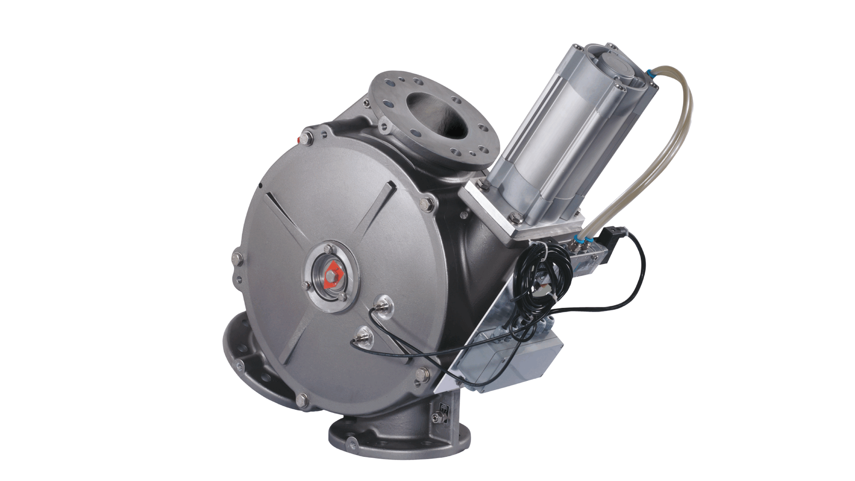
Diverter Valves
Designed to handle dry materials such as powders, pellets, and granules with minimum degradation in pneumatic conveying and gravitational applications.
Application area: food, pet food, chemical, plastics, pharmaceutical and other process industries.
Diverter range consists of DTD dual channel and SDTD single channel plug diverters, BTD ball diverters, RD flap diverters and GFD gravity flap diverters.

Slide 20
Services
Installation Commissioning Modification
Maintenance Of System
Consultation On Dust Explosion
Engineering Services- Plant Audit &Plant Inspection

Slide 21
For more…
Website: www.nutshellengg.in
Follow us….
Please like, share, and subscribe my YouTube channel….
Press the bell icon and never miss any updates

